Slide 1

CAPSTONE PROJECT
Electric vehicle charging stations in England
How effectively have they been placed in relation to high density traffic?
Notes:
With this project, I wanted to evaluate the current placement of Electric vehicle charging stations in England, and essentially determine what was the strategy for their placement?

Slide 2
Initial hypothesis
‘The number of EV charging points within a specific location can be determined by the relative traffic flow around that area’
Methodology:
Aggregate charging points per location
Determine a measure of traffic flow around that location
Use regression models to see if traffic can predict number of charging points within an area
Notes:
Initial hypothesis – in simple terms, that demand would dictate supply and areas with high traffic flow would also have a high number of charging points for cars
Why? Massive increase in the number of EV cars in the past few years increase. Sales increased by 76.3% in 2021 – determine whether the infrastructure was there to support this growth and whether it was where I deemed it logical

Slide 3
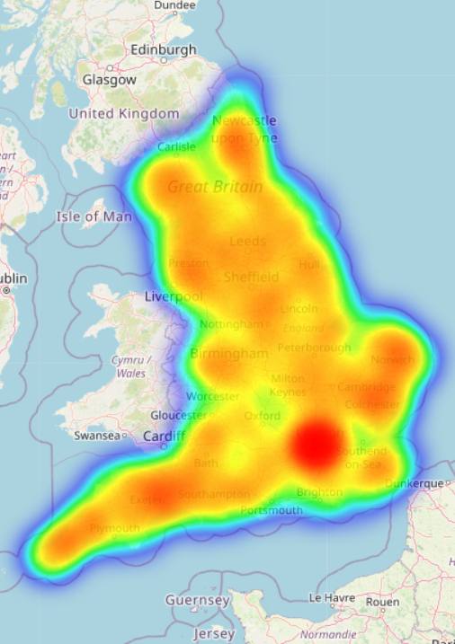

Aggregation of charging points
Charging point data from the National Charge Point Registry (~25,000 in UK)
Data cleaning & extraction of features
Charging points aggregated by postal code (e.g., NC1)
Charging data joined with supplementary information regarding each postal code (coordinates, rural or urban etc.)
Notes:
Initial look – areas of high density around cities

Slide 4

How to determine traffic flow?
What kind of traffic is the problem considering?
From where can this data be sourced?
Notes:
Range anxiety

Slide 5
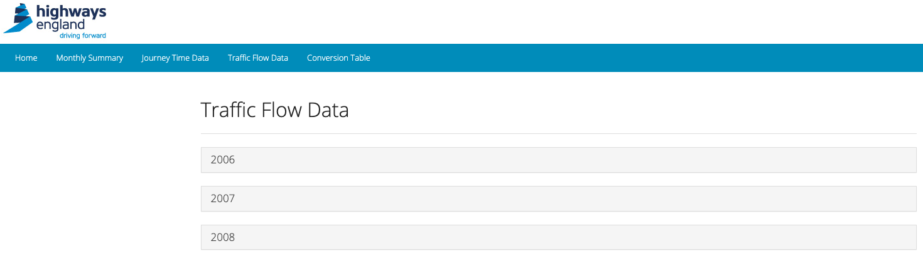

Data wrangling: Highways England
What data does this site contain?
Timestamped traffic data stored as downloadable zip files for various sites along England’s motorways and major A roads
What was extracted?
122550 download links to CVSs containing:
2022 traffic data
for 153 roads
and >9000 sites along the roads
Notes:
Data sourced from highways England – traffic data organized per road – giving traffic flow data for the major roads in England
Using web scraping methods, I

Slide 6
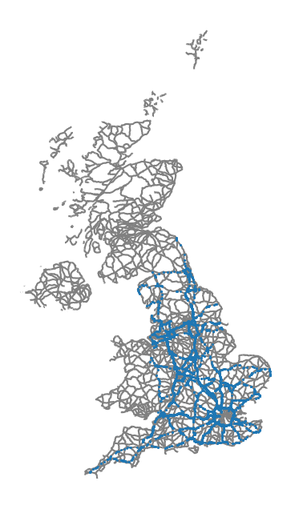

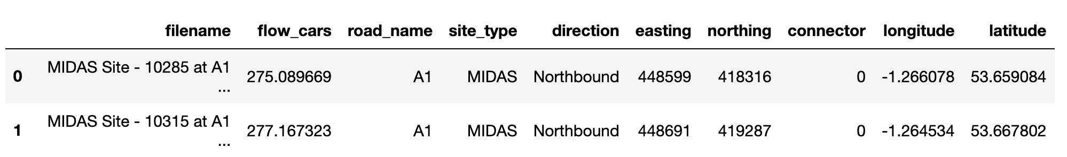
What was the output of data wrangling?
Average number of cars passing through 9049 locations along major roads in England per minute
Notes:
Each dot location on the map – obtained an average number of cars passing through every minute.
Also extracted coordinate location ffrom the filename – first in easting and northing, which I then converted to longitude and latitude

Slide 7
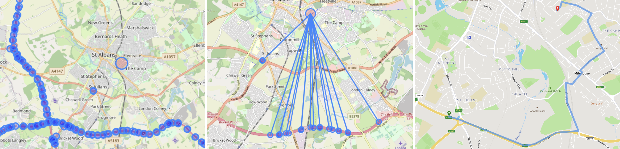
Determining Traffic flow
Determine direct distance between each postal code & traffic site
Map the the 20 shortest driving distances per postal code
Determine the closest traffic site & the traffic flow at this location
1
2
3

Slide 8

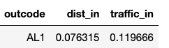
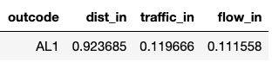

Calculating a metric of traffic flow
Iteration 1:
Reduced the impact of the traffic relative to distance
Initial calculation:
f = calculated metric of traffic flow
d = distance to the closest main road (scaled between 0 & 1)
t = average traffic flow at the closest main road (scaled between 0 & 1)
Example:
Original data:
Iteration 2:
Removed outliers
$$f=\left(1 −d\right) × t$$
Scaling distances & traffic:
(1 – distance) x traffic
Further improvements?

Slide 9
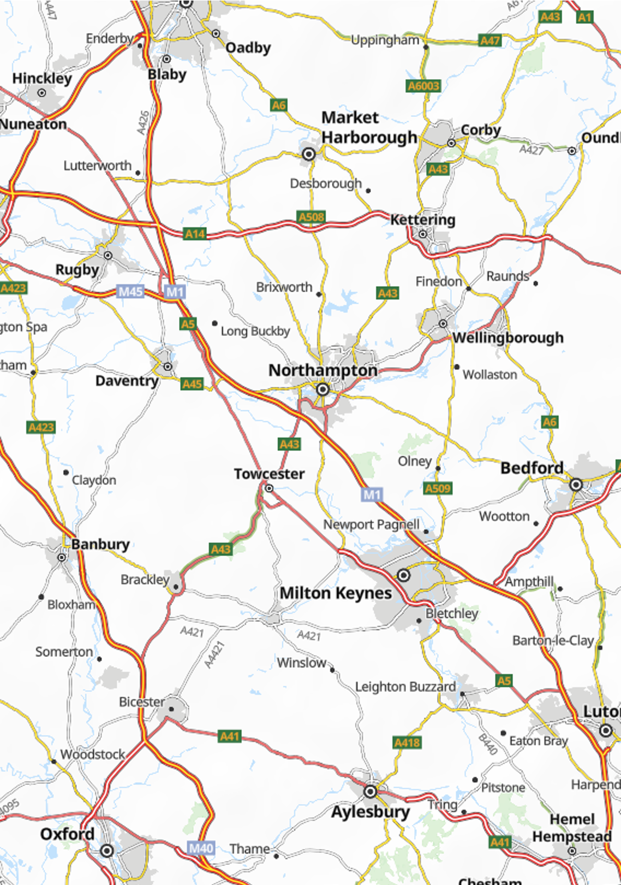
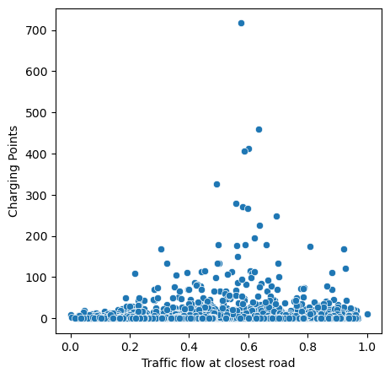
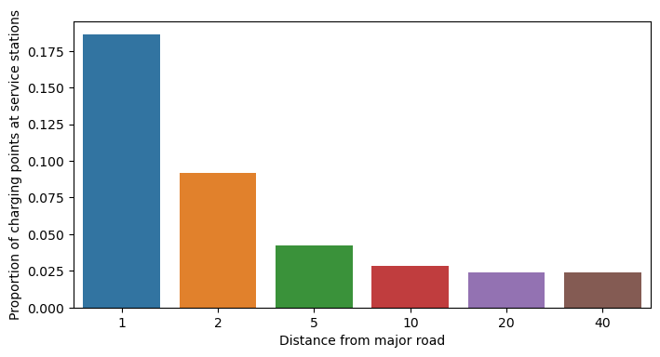
Can charging point locations be predicted from traffic flow?
Pearson’s correlation of less than 0.1 between number of charging points and traffic flow (essentially no correlation)
Linear regression accuracy score of 0.03 on a test set
Other variables & research point to distinct lack of focus on motorway/ major traffic when installing EV points
Notes:
Can charging points be predicted from traffic flow? In short, the answer is no.
Immediately when plotting and looking at correlation coefficients this can be seen – coef so close to 0 , essentially saying there is no correlation

Slide 10
What does
determine the locations of EV charging stations?
Notes:
So that begs the question, what does determine the location of these EV charging stations? What was the strategy when installing them?

Slide 11
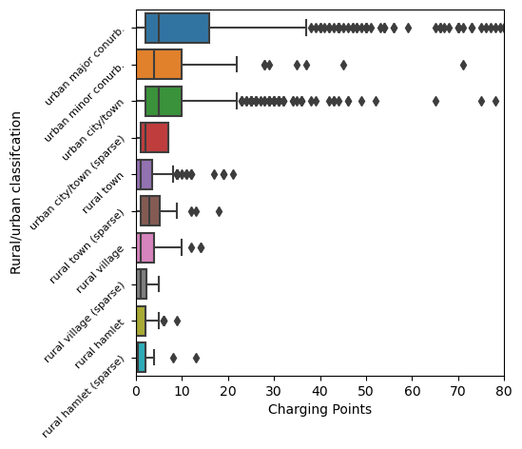
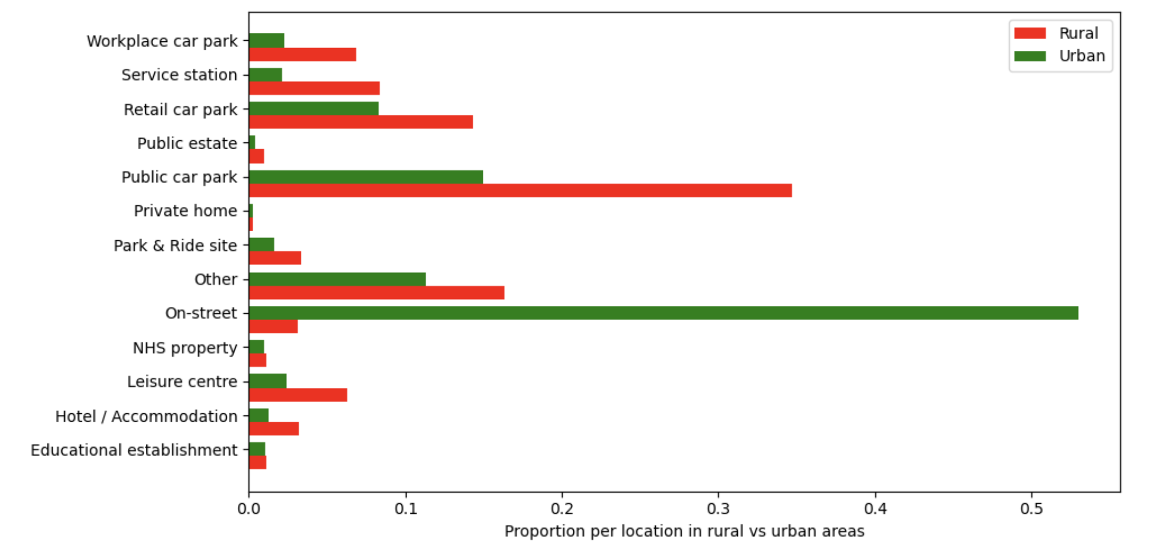
Investigating Other Variables
Notes:
Other factors investigated – rural vs urban areas
Much higher distribution in urban areas – additionally huge lack of on street charging points in rural areas
Proportion
Only 1000 on street charging points outside of London – in rural areas, have to travel to charge your car?

Slide 12
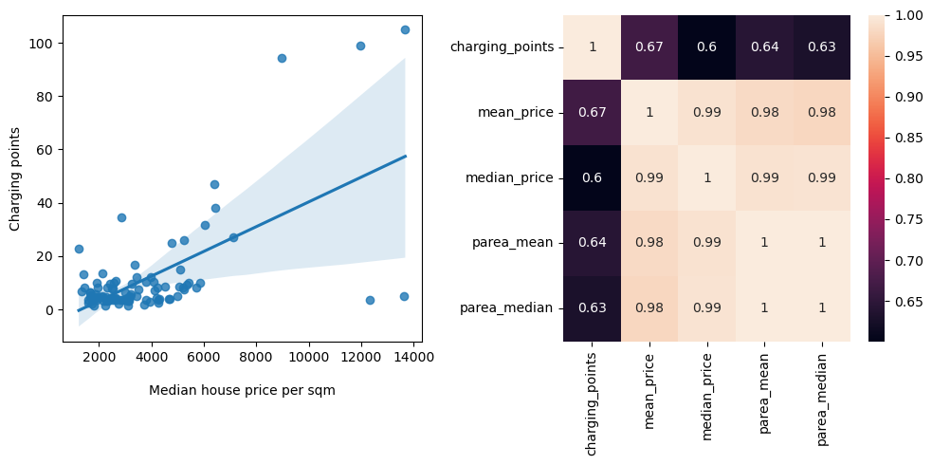
Comparing geographical areas
Grouping by geographical district (first letter or two letters of post code e.g., ‘NW’), shows a massive spread
Some correlation seen between districts with high numbers of charging points, and high house prices Almost half of charging points in London

Slide 13
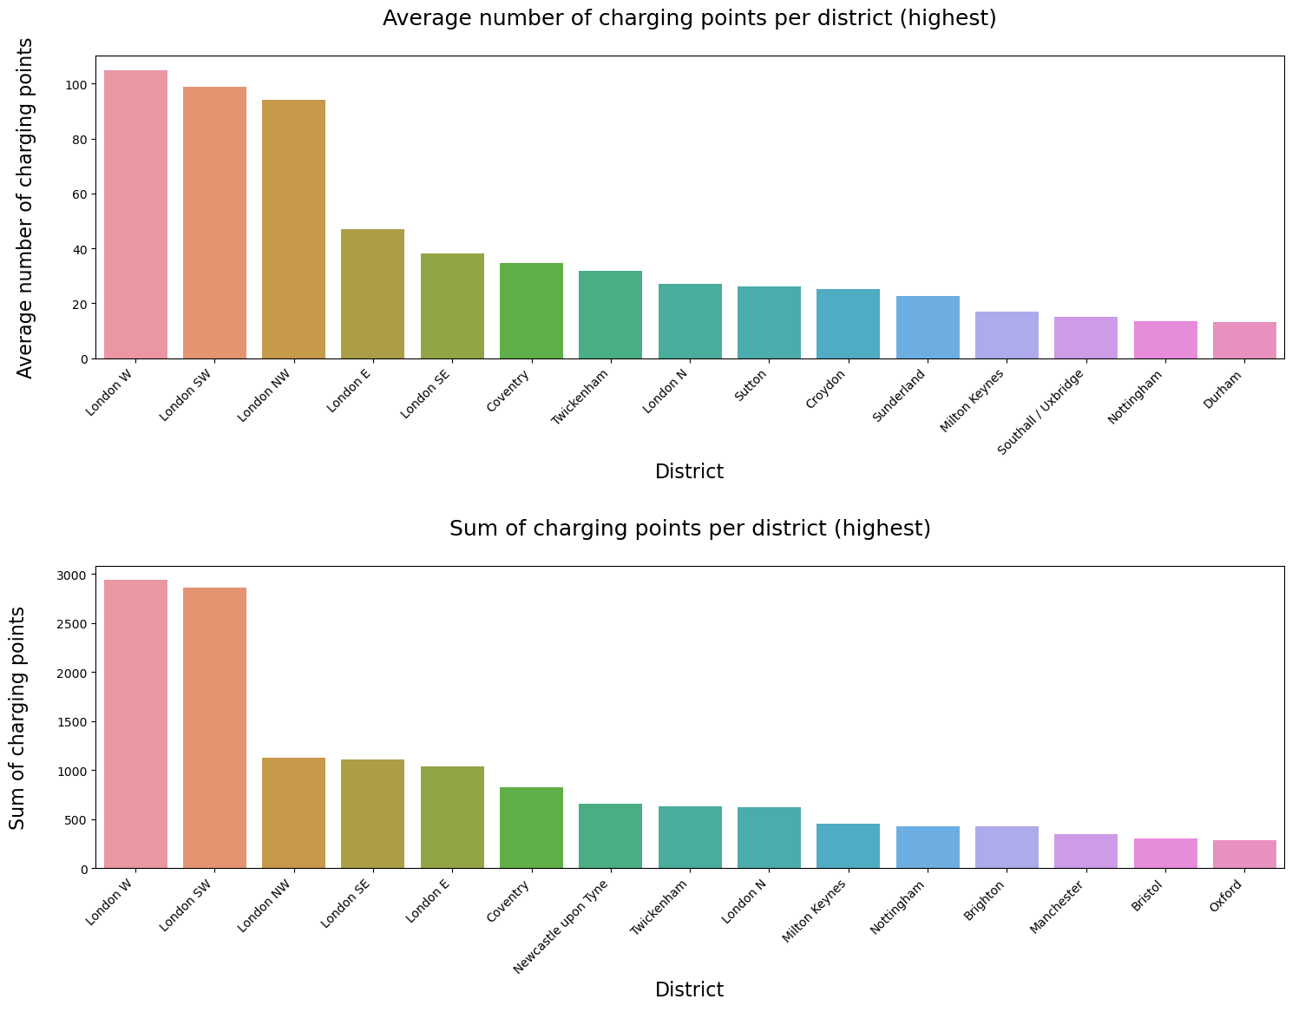
Comparing geographical areas
Grouping by geographical district (first letter or two letters of post code e.g., ‘NW’), shows a massive spread
Some correlation seen between districts with high numbers of charging points, and high house prices Almost half of charging points in London

Slide 14
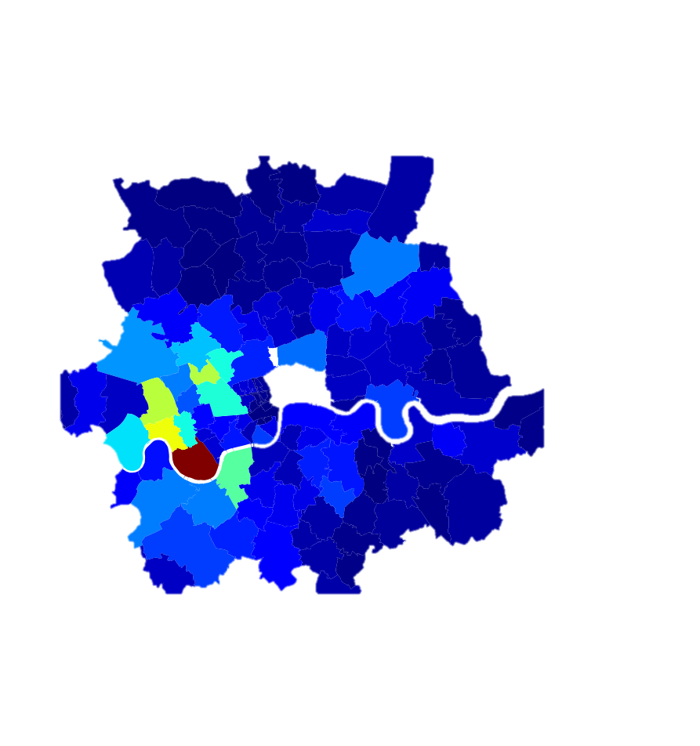
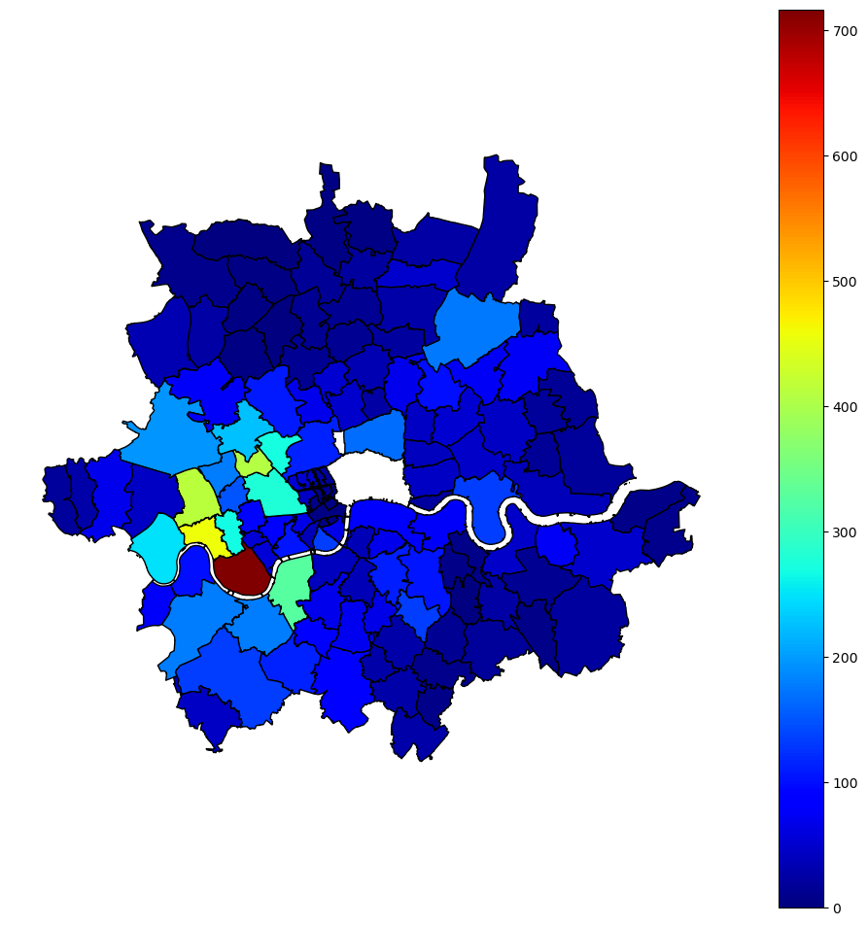
What’s so special about London?
High concentration in London with 42.5% of all charging stations in England located here
Equally, areas of sparsity with 0 charging points
How can these observations be explained?
Population?
Affluency?
ULEZ zone?
Notes:
Dark blue = 0
Bright colours = high density
What is separating this areas that have 10 or less,to areas that have up to 700?
Investigated some different theories. To some extent likely all having an impact, but the thing that I found to be really interesting was the clustering of densities based on the local authority covering an area

Slide 15

What’s so special about London?
Hammersmith & Fulham Council
Notes:
Dark blue = 0
Bright colours = high density
What is separating this areas that have 10 or less,to areas that have up to 700?
Investigated some different theories. To some extent likely all having an impact, but the thing that I found to be really interesting was the clustering of densities based on the local authority covering an area

Slide 16
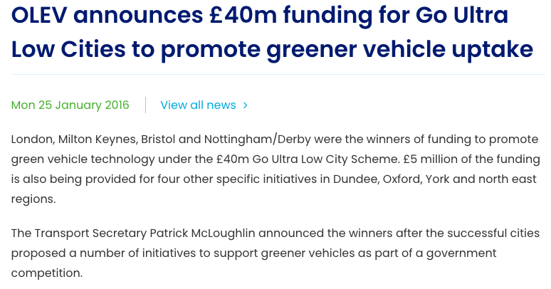



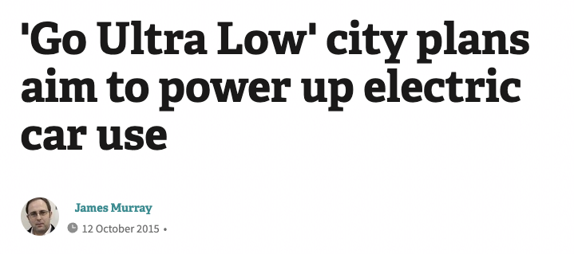
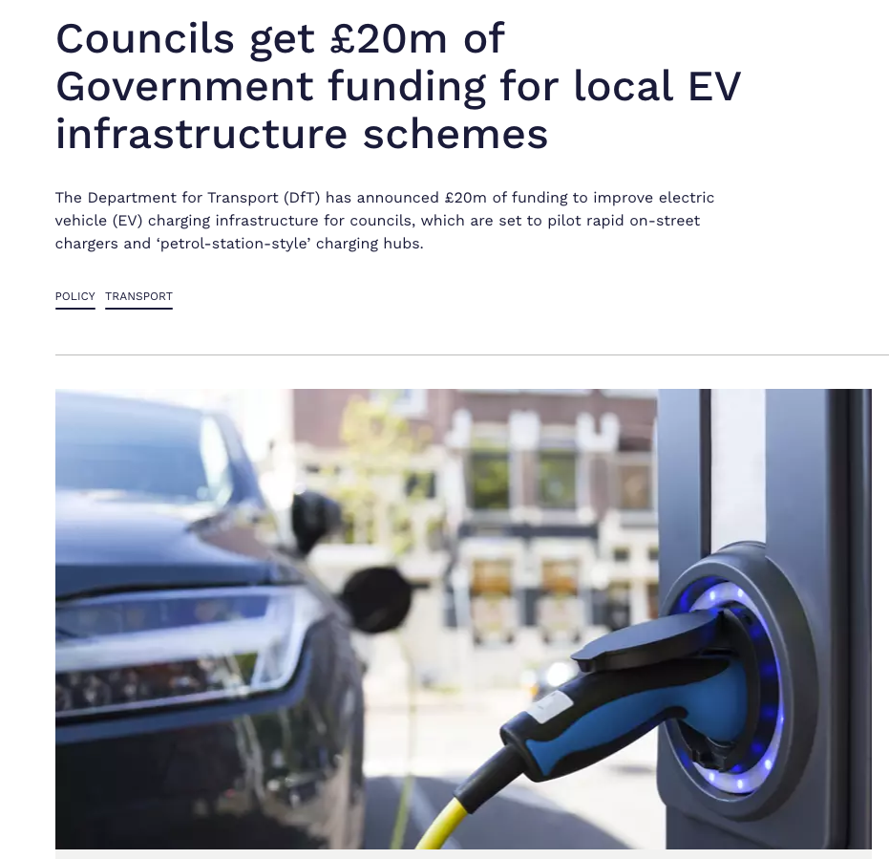
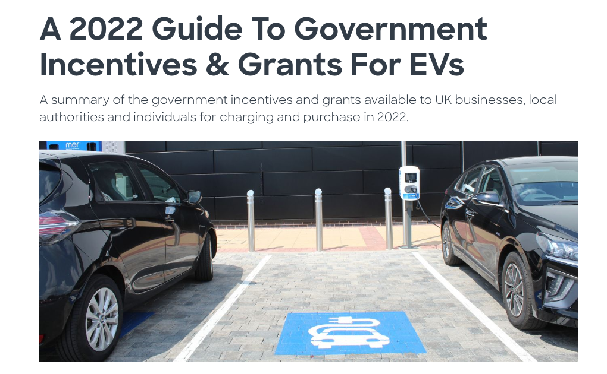

Impact of local government
Local government schemes include:
Ultra Low City Scheme
Awarded areas including London, Bristol & Milton Keynes £40 mil in 2016 for initiatives to support EV charging
Ultra Low Emission Taxi Infrastructure Scheme
Awarded several local councils funding for implementation of taxi EV charging infrastructure
On-Street Residential Chargepoint Scheme
Ongoing funding & advice for local authorities to implement EV stations

Slide 17
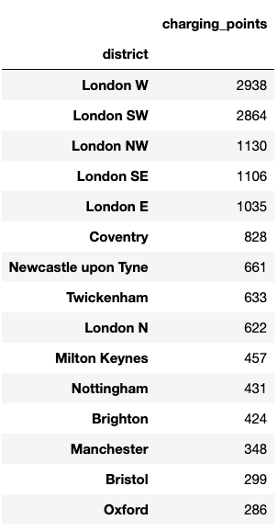
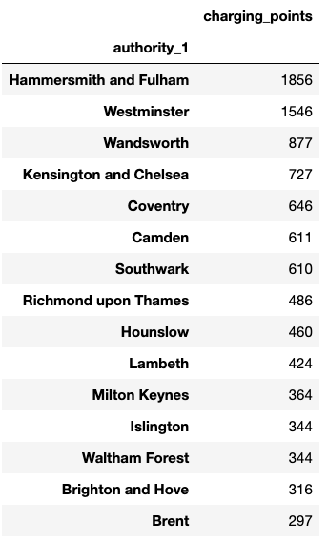
Impact of local government
Go ultra low city scheme winners included:
London & greater London
Milton Keynes
Nottinghamshire
Bristol
Oxford
Ultra Low Emission Taxi Infrastructure Scheme winners included:
Brighton and Hove City Council
Bristol City Council
Newcastle Borough Council
Coventry City Council
Notes:
Largest amout - £13 million went to London councils & greater London authority

Slide 18
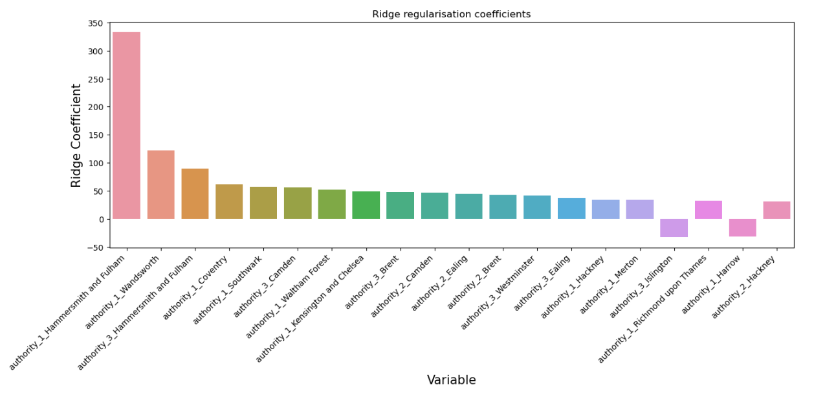
Can a model accurately predict charging points per area?
Investigated different combination of variables
Best model: linear regression with ridge regularization
Using only local authorities and urban vs rural:
Accuracy score = 0.615
Notes:
Intially was looking at a a range of features – district, urban v rural, house price – spent a long time tuning to find a max test score of 0.365
Intersting that JUST using local authorities and whether an area was urban or rural could explain this variance

Slide 19
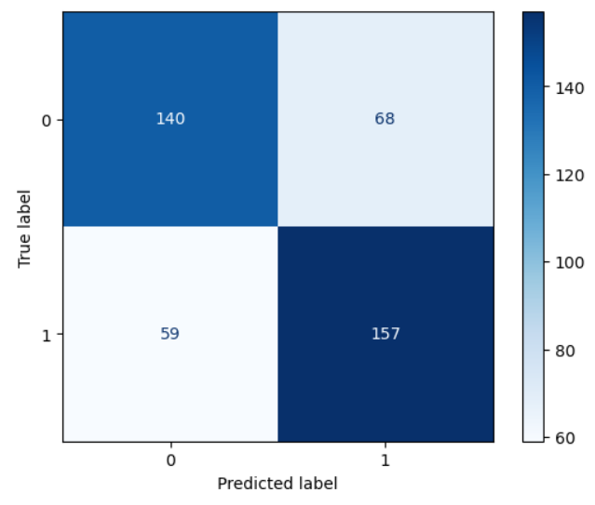
Classification Models
Due to the high skew of the target variable, also investigated the results of a classification problem
Predicting ‘high’ vs ‘low’ number of charging points
Baseline of 0.5
Best model was a tuned logistic regression model:
Accuracy score: 0.700
Relationship between different variables should be further investigated
Notes:
Could also get good results with districts in comb with other params

Slide 20

Summary & further work
Predictions
Long distance traffic is not a good indicator of charge point locations & cannot predict them
Councils, and rural coding can predict number of charging points with 0.615 accuracy and areas of high vs low charging points with an accuracy of 0.700
Limitations
Could only map to one traffic point per postal code (limited by API calls)
Only considering long distance traffic and not local traffic
Does the NCR represent the true number of publicly funded charging stations?
Further work:
Which areas are really underserved in terms of charging points?
Notes:
In summary - what is driving the installation of EV points in specific areas? I started out with the expectation that the market would respond to demand, and areas of high traffic flow would have high number of charging points. However, the real driver appears to be public policy and local authorities bidding for funding. Using a model to predict found x, y,z . However, what is driving how this bids are awarded? Further work – dig into areas that are really underserved
Expect the market economy would respond to demand – lots of traffic = lots of charging points. Public policy

Slide 21


Does the current government strategy make sense?
Notes:
I was left with the feeling after this work that massive focus is being put on big cities, perhaps areas of higher affluency etc. However rural areas where they are quite reliant on their cars & actually looking at motorway traffic – have a very high traffic flow are left underserved

Slide 22
Questions?

Slide 23
Appendix slides

Slide 24
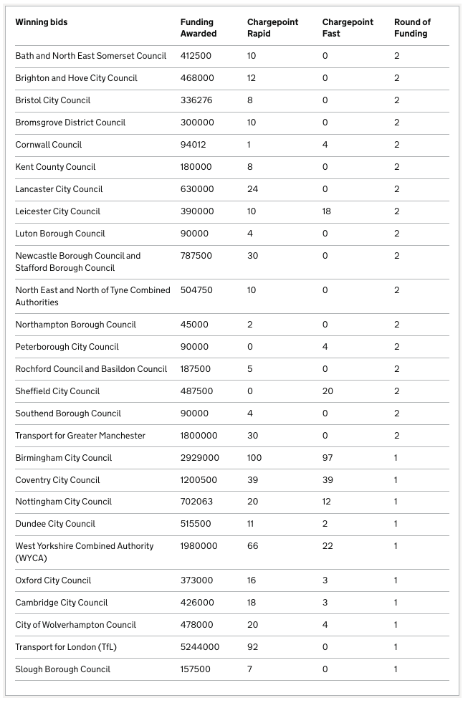
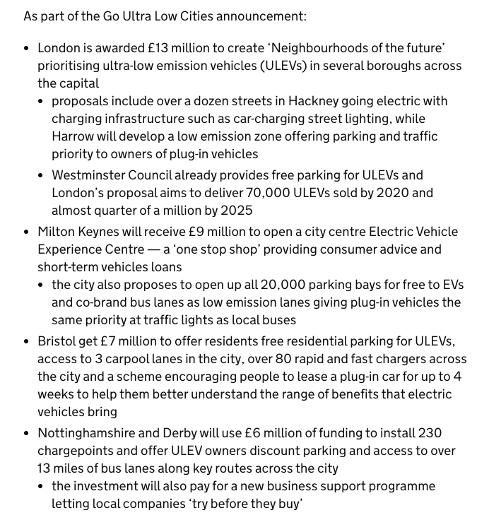
Government schemes winning bids

Slide 25
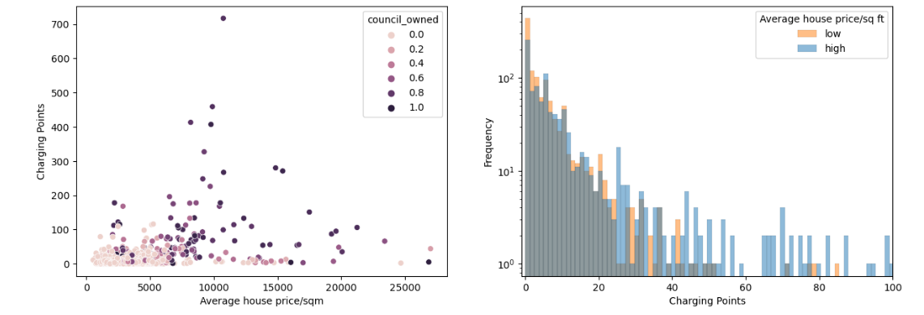
What distinguishes urban areas with charging points to those without?

Slide 26
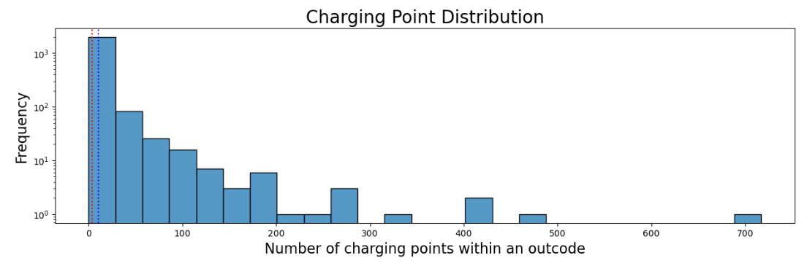
Skew of target variable

Slide 27
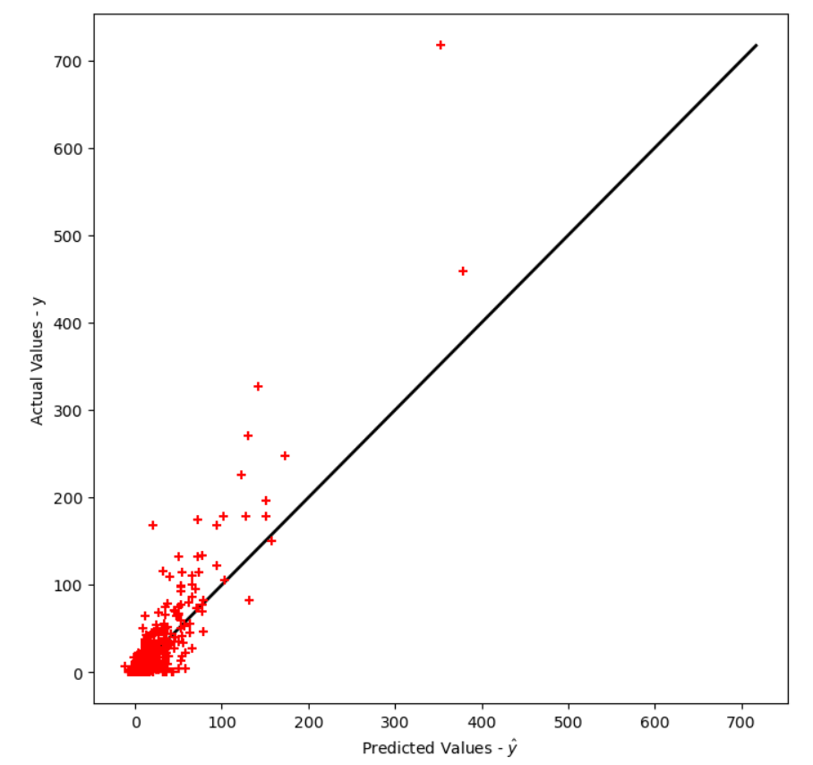
Skew of target variable

Slide 28
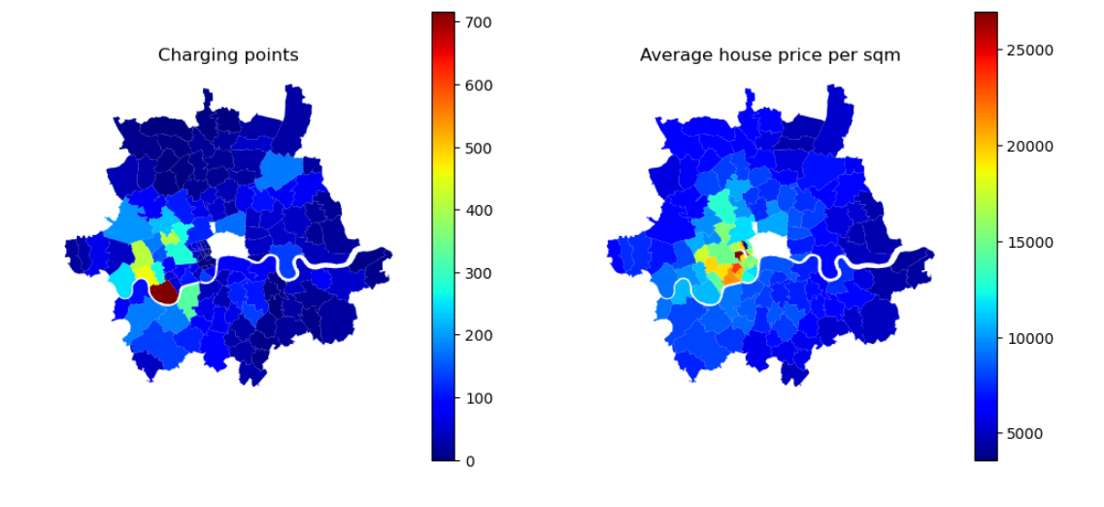
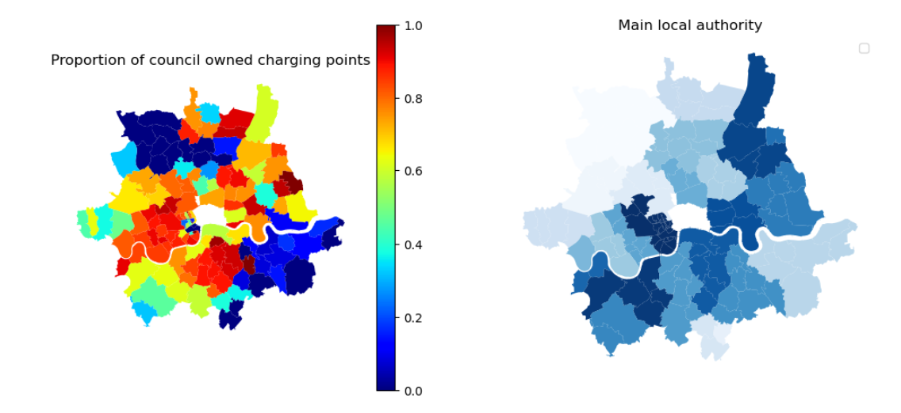
Explaining London charging points

Slide 29
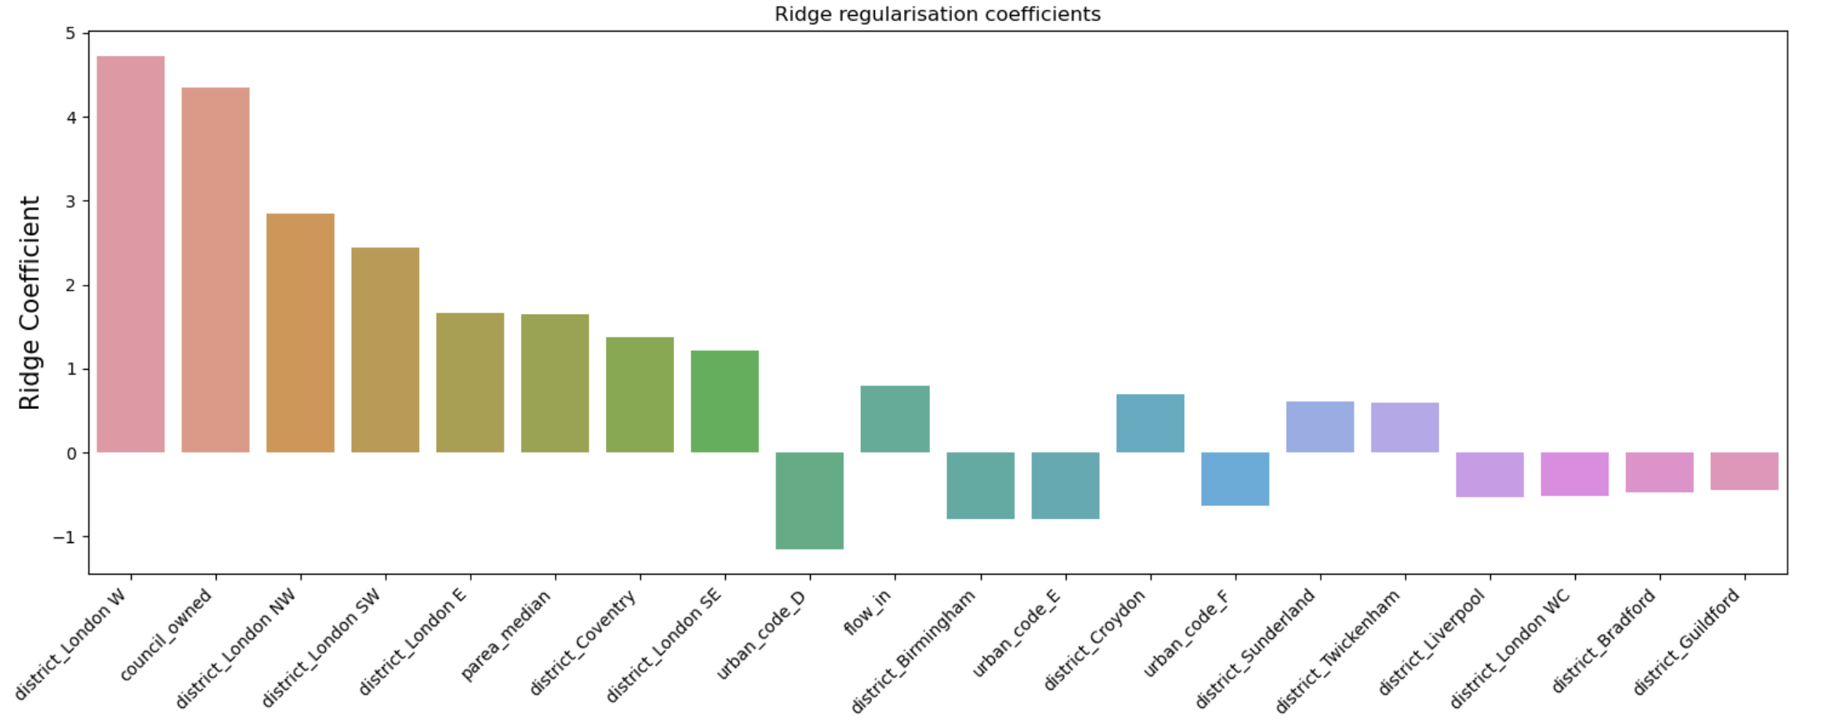
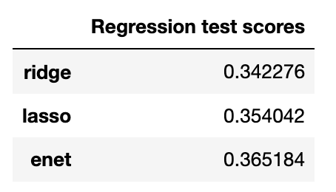
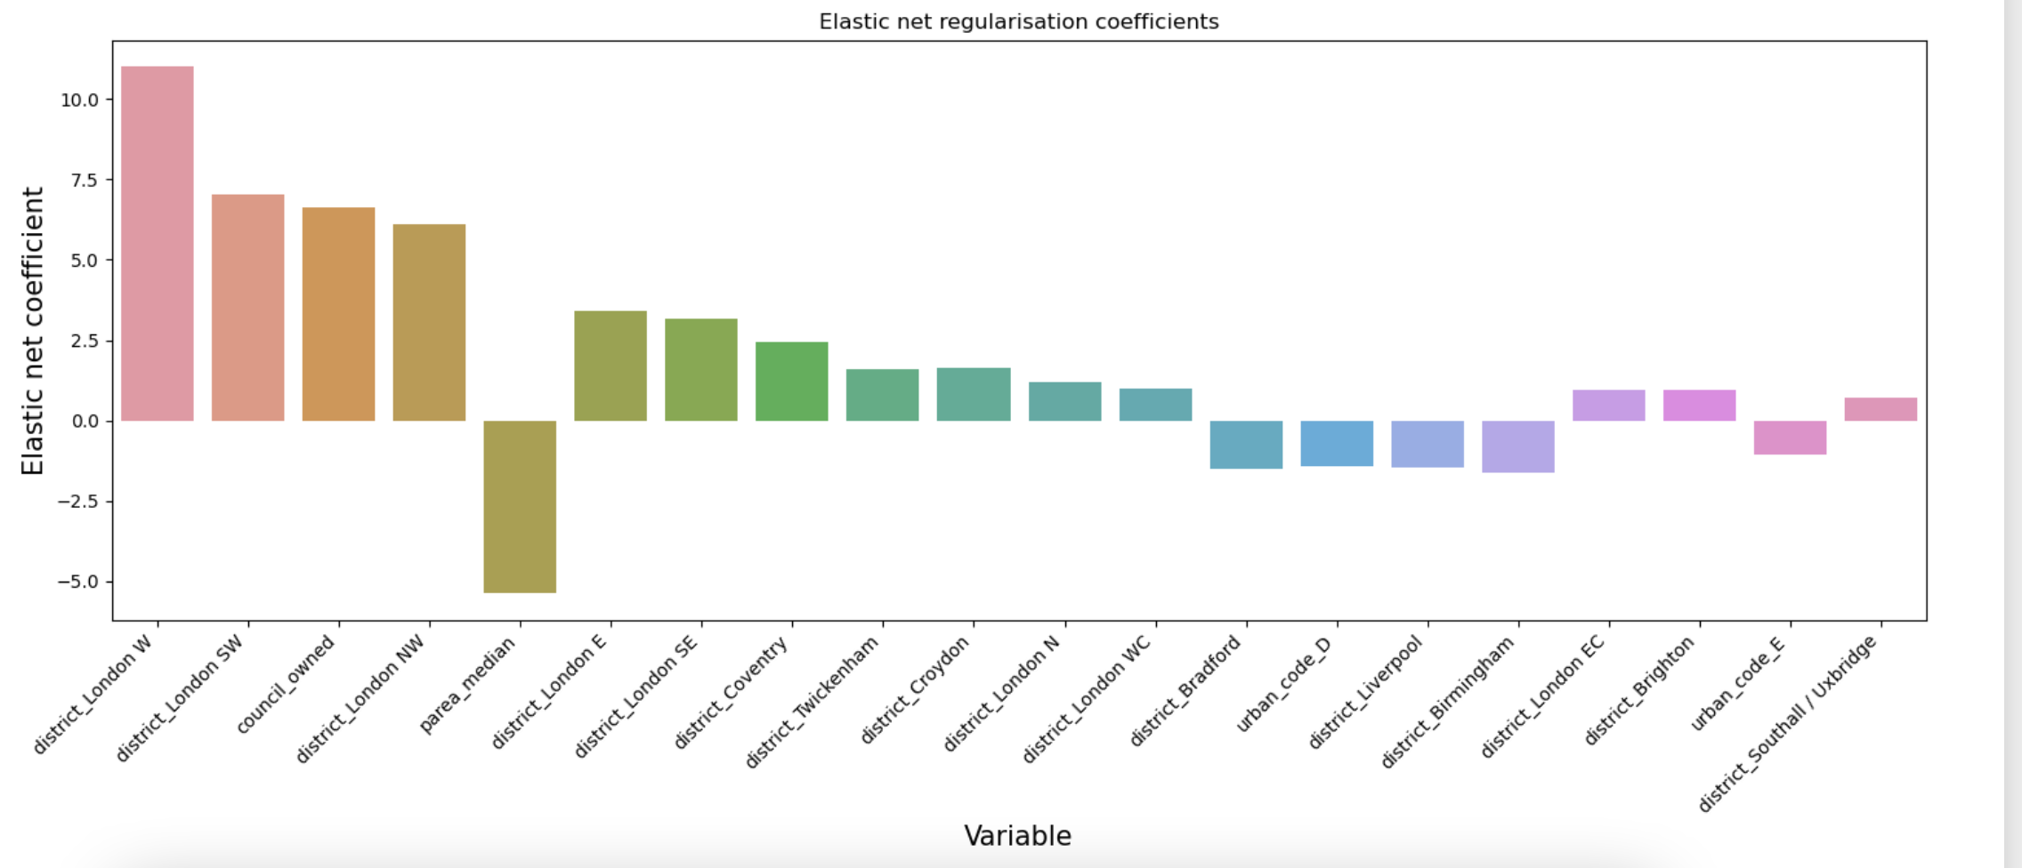
Initial models with district/house price/rural vs urban

Slide 30
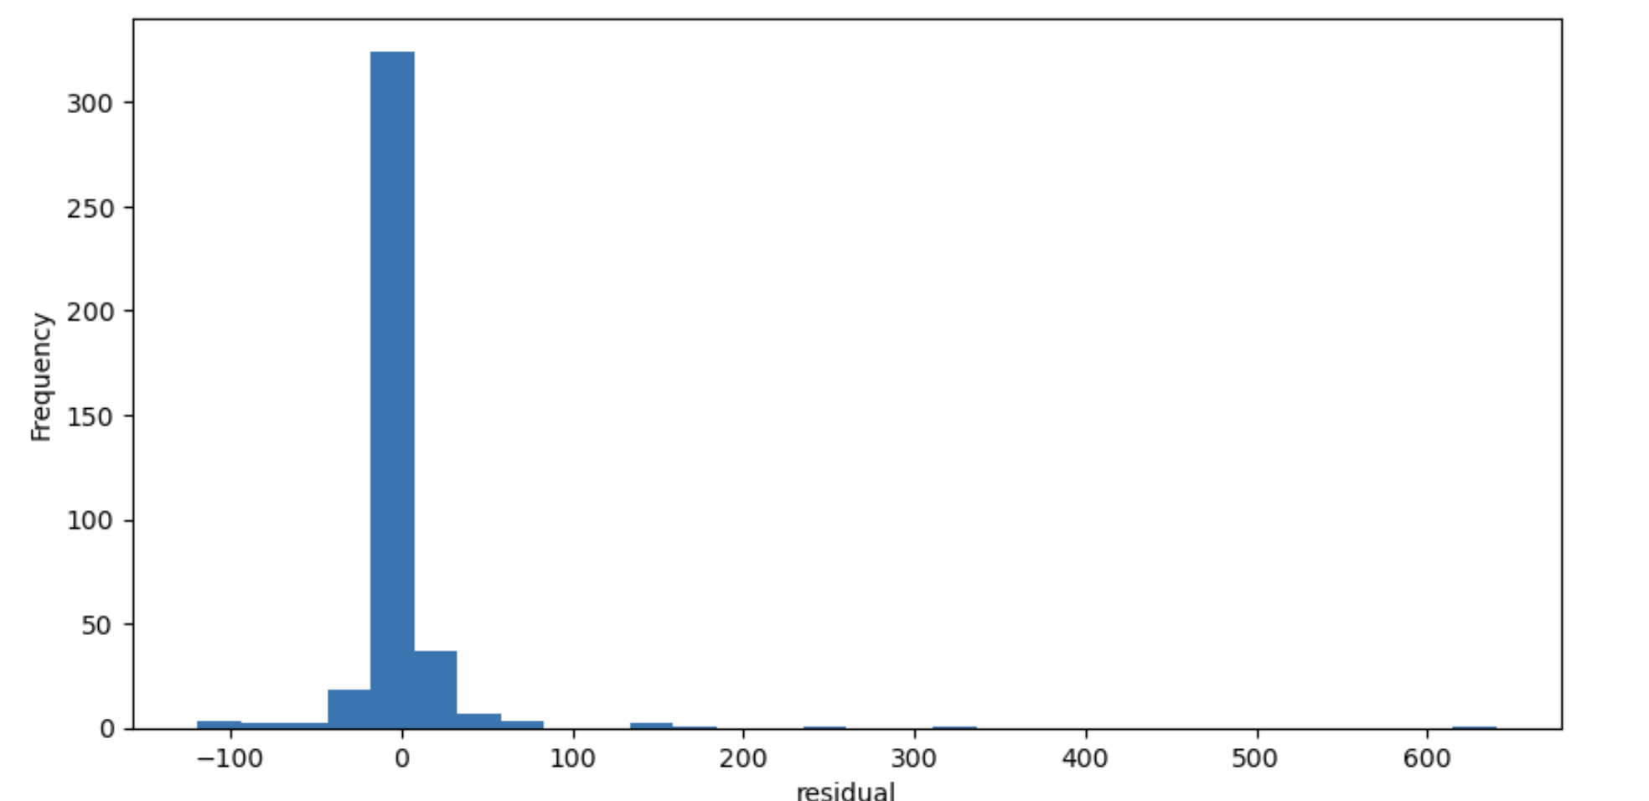
Initial models with district/house price/rural vs urban

